Slide 1
PNWARS Mar ‘16
Freight Cost Complexities–The Price of Not Knowing
Summer Bartczak, PhD
sbartczak@amtr.com

Slide 2
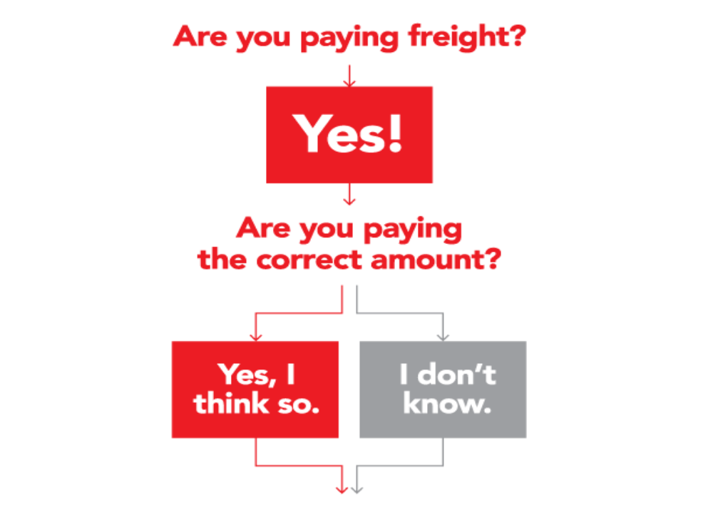
Introduction
Our focus
today
What to do?

Slide 3

Introduction
Freight cost auditors work at the intersection of shippers & carriers
Despite best efforts of both parties, things go wrong all the time
Why? Variety of factors are increasing the complexity of determining correct freight costs
Given conference theme and our education mission, we wanted to share a little of what we know/see everyday

Slide 4
Overview
High-level drivers of freight complexity
Freight complexity examples/stories
What’s the price of not knowing?
What to do about it?

Slide 5
High-level Drivers of Freight Cost Complexity
Deregulation
  Past: Interstate Commerce Commission (ICC) drove standardization
  of transportation rules and rates
  Present: No standardization—millions of rules and rates
Technology
  Automation
  Lack of systems integration/too much systems integration
  Internet/web-based applications
Good things with unintended consequences!

Slide 6
Freight Cost Complexity--Automation
Types of automated systems encountered
  Transportation management systems (TMS), order entry systems, enterprise systems, etc.
  Implemented w/little training; little understanding of what goes on behind the screen
  Often force changes to existing business practices; smart people get lost
Scholarly research on automation
  Substitution myth
  Complacency & bias
Reality is no automated program or machine is infallible
  Will break/encounter circumstances never anticipated
  With more complexity & interconnection failures become even harder to detect
Examples: manual overrides, accessorial charges
Notes:
Lots of scholarly research on automation
Substitution myth- Like believe that automation frees us to spend our time on higher pursuits but doesn’t otherwise alter the way we behave or think. Scholars know automation simply supplant human activity but rather changes it, often in ways unintended and unanticipated by the designers of automation
Complacency & bias–
Automation complacency occurs when a computer lulls us into a false sense of security. Confident that the machine will work flawlessly and handle any problem that crops up, we allow our attention to drift. We become disengaged from our work, and our awareness of what’s going on around us fades. Automation bias occurs when we place too much faith in the accuracy of the information coming through our monitors. Our trust in the software becomes so strong that we ignore or discount other information sources, including our own eyes and ears. When a computer provides incorrect or insufficient data, we remain oblivious to the error.
Observers vs. actors--The way computers can weaken awareness and attentiveness points to a deeper problem. Automation turns us from actors into observers. Instead of manipulating the yoke, we watch the screen. That shift may make our lives easier, but it can also inhibit the development of expertise.
Reality is no machine is infallible.
Will break
Will encounter circumstances never anticipated
With more complexity & interconnection failures become even harder to detect
Have to operate in a imperfect world

Slide 7
Freight Cost Complexity—Knowledge Loss
Transportation-specific knowledge loss
  Experts becoming fewer
  Organizations have forgotten what they knew
  Supply chain management (or logistics management) is new focus
  Education opportunities dwindling
Examples: Familiarity w/rules tariffs, contract/rate tariff interpretation, ISS procedures
Notes:
Internet/no history/here & now/ problems crop up later

Slide 8
Freight Cost Complexity—Governing Documents
Governing docs still exist—there are just more
  Circular/Tariffs/Contracts/Quotes
Creation & Implementation
  Marketing/Sales/Logistics/Accounting involved
  Content vague/missing/”Intent”
  Update/Publishing/Copy & Paste errors
Publishing online
  Eliminates history/archive
  Here & now approach when problems recognized later
Examples: Contract uses city/Rate system based on Railhead

Slide 9
Freight Cost Complexity—Decentralization
Decentralization of transportation function into various components:
  Accounting/Logistics/Supply Chain/Sales/Marketing
Disconnects people/processes/data associated with freight
Makes coordination, oversight, & problem resolution very difficult
Example: Accounting responsible for disputes yet not transportation trained

Slide 10
Freight Cost Complexity—Mergers/Acquisitions/Systems Conversions
Merger/acquisition scenarios are hard enough
Systems/process integration that follows is often harder
Transportation/Freight systems are especially susceptible
Freight cost problems & errors escalate during such a transition
Example: duplicate payments, incorrect rate assessment because systems don’t communicate

Slide 11
Freight Cost Complexity—Lack of Time
Tighter deadlines
Higher priorities than freight/freight cost
Increased expectations
Lack of time to deal with the complexities
Examples: paying bills w/out time to verify

Slide 12
Complexities Drive Freight Cost Problems Such As…
Complexity
Freight Cost Problem
Automation
Knowledge loss
Governing Docs
Decentralization
Mergers/acquisitions
Lack of time
Paid for invoices without checking rates because you didn’t want to pay finance charges?
Used a “work-around” for your freight payment system to get the invoice paid when it was denied?
Balance due for accessorial charges you didn’t know existed?
Paid the wrong fuel or wrong mileage?
Paid a higher tariff rate than contract rate?
Car billed for a move it didn’t make?
Car moving empty that was found to be loaded?
Charged for a empty cars on “free” return/diversion?

Slide 13
What’s the Price of Not Knowing?
The price of not knowing about freight cost complexities
  #1. You can’t take action!
    Can’t understand the nature of problems
    Can’t do anything about them
    Ignorance is bliss, but…

Slide 14
What’s the Price of Not Knowing?
The price of not knowing about freight cost complexities
  #2. It will cost you money!
        Billing errors (shippers & carriers)
        Productivity/Efficiency losses
        Can’t make well-informed financial tradeoff choices

Slide 15
What to do?
Awareness
  Become familiar with the sources of freight cost complexity
  Can help you identify where the problems may exist/are generated
Education
  Formal/informal
  Transportation-focused
  Professional Community

Slide 16
What to do?
Be wary of technology/automation
  Know what knowledge/expertise you are giving up
  Keep people engaged as much as possible
    Computer operators end up functioning as mere monitors/passive watchers of screens
    Experienced operators eventually act inexperienced
  Demand to know/investigate what is going on behind the screen
  Don’t be lulled by a “false sense of security”
Notes:
Computer designers see human operators as “unreliable and inefficient,” so they strive to give the operators as small a role as possible
So operators end up functioning as mere monitors, passive watchers of screens.
Because skills “deteriorate when they are not used,” even an experienced operator eventually begins to act like an inexperienced one

Slide 17
What to do?
Put people on the task
  Internal
    Complexity requires human attention
    Human engagement increases knowledge; “knowing demands doing”
  External
    Consultants (process improvement & knowledge creation)
    Auditors (Have time to do what you don’t/ educate)

Slide 18
Summary
So what do we need to know??
  Remember that transportation is the largest variable cost the supply chain—it deserves our attention
  Lot of factors driving freight cost complexity
  Examples familiar? You are not alone & not stupid
  Wish we could “Google” the answers or ask Siri, but it’s too complex for that approach as well
  Much of the solution lies bringing “old fashioned”, human knowledge to bear on problems & sharing what we know

Slide 19
PNWARS Mar ‘16
Freight Cost Complexities–The Price of Not Knowing
Summer Bartczak, PhD
sbartczak@amtr.com

